Slide 1
Introduction to React Native

Slide 2
Objectives
Understand the React Native
Advantages and disadvantages of React Native
Risks and drawbacks of React Native

Slide 3
What is React Native?

Slide 4
What is React Native?
React Native is an open-source framework for JavaScript Mobile from Facebook that is specifically designed to build iOS and Android mobile apps.
React Native is based on the ReactJS JavaScript library, which helps build user interaction for mobile platforms.
Currently, React Native is used in other popular apps like Facebook mobile app, Instagram, Pinterest, Skype, etc.

Slide 5
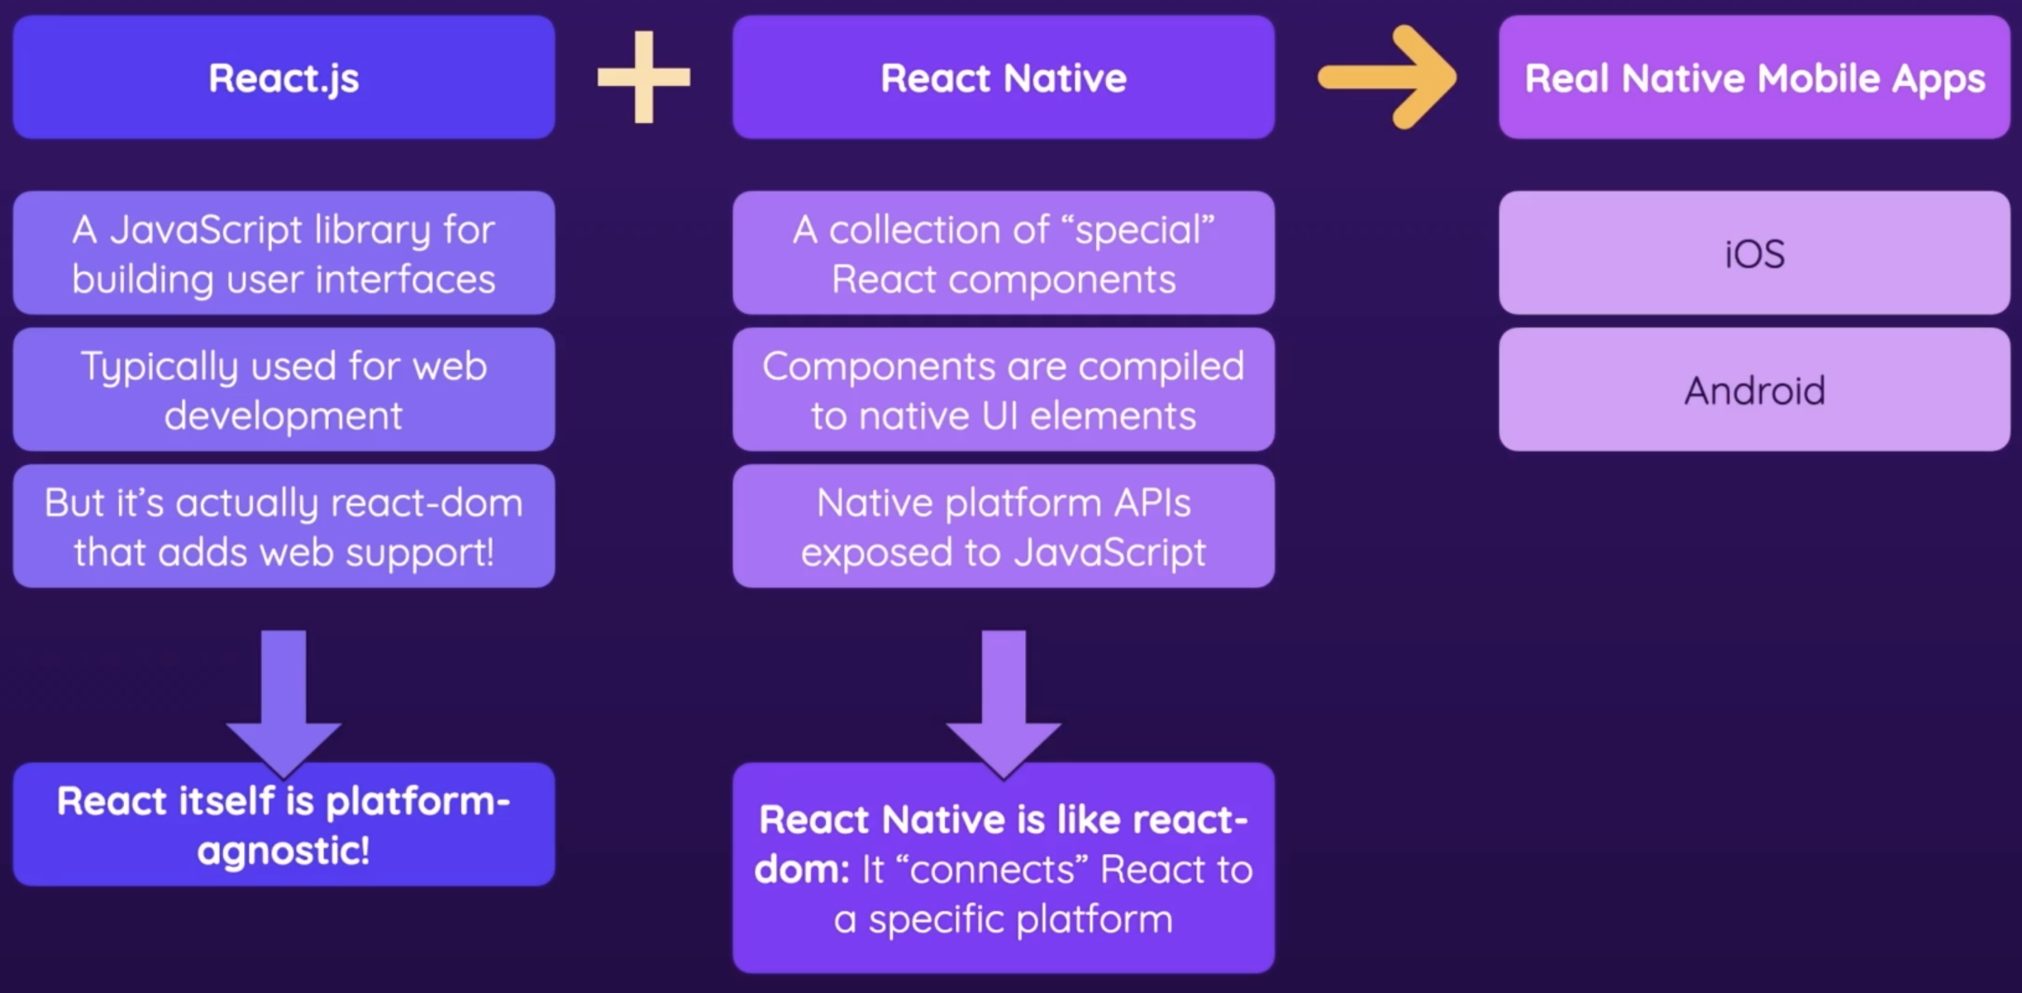
What is React Native?

Slide 6
The key features of React Native
Cross‐Platform Support:
Use React Native to build native applications without learning Kotlin or Java for Android and Swift or Objective-C for iOS apps.
You can also write one common code, and React Native will take care to display it on iOS and Android.
React Native Components:
Provides native components such as View, Text, and Image that can be converted to native iOS or Android UI.

Slide 7



Example of using a React Native
iPhone 13 ProMax - iOS 15.2
Pixel 5 API – Android API 34 Google APIs | x86_64

Slide 8
JSX
React Native uses JSX, XML coding replacement for HTML and CSS. The benefits of JSX are as follows:
It is faster because it makes improvements while compiling code in JavaScript.
It is also safe and most errors can be caught during integration.
It makes it easier to write templates if you are good with HTML.

Slide 9
About React Native Release
The first version of React Native was released by Facebook in 2015.
As per the official React Native website, in 2018, React Native had the second-highest number of contributors as compared to other repositories on GitHub.
Today, React Native is sup- ported by donations from individuals and companies around the globe, including Callstack, Microsoft, Expo, Infinite Red, and Software Mansion. The Facebook community has been extremely active and updates projects regularly with new updates across all platforms.

Slide 10



Prerequisite
Basic knowledge of HTML, CSS, and JS.
Basic knowledge of ReactJS.
NodeJs should be installed in your system.

Slide 11
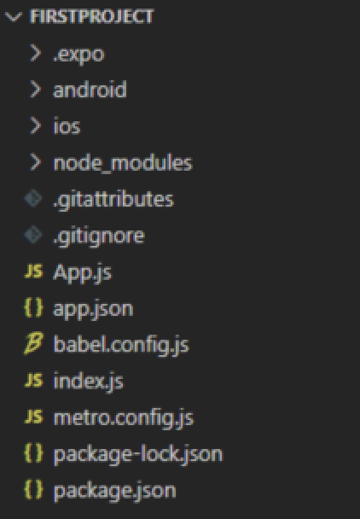
Basic installation
We use the Expo CLI version that will be much easier to use in your React Native applications.
Step 1: Open your terminal and use the command below:
npm install -g expo-cli
Step 2: Now the Expo CLI is installed worldwide, so you can create a project folder using the command below.
expo init “projectName”
Step 3: Now create one folder and start the server by using the following command given below:
cd “projectFolder” npm start application_name
Project structure

Slide 12
History of React Native
Facebook developed React Native in 2013 through their in-house hackathon project. Later, it was released publicly in January 2015 as React.js, and in March 2015, Facebook announced that React Native was open and available on GitHub.
React Native was originally designed for the iOS app. However, recently it also supports the Android operating system.

Slide 13

History of React Native

Slide 14
Advantages and Disadvantages of React Native

Slide 15
Advantages of React Native
Community support
As an open-source framework, React Native allows the entire developer community to browse all documentation related to this technology for free and allows them to contribute to it whenever they want.
Proper performance
The performance of the platform lies in improving performance using traditional modules and controls. It works with native Android and iOS components and continues to generate codes in native APIs without interruption.
Reusable code and Advanced components
This helps to reduce project time and cost and is the god of all businesses and app developers.

Slide 16
Advantages of React Native (contd.)
Benefits of Live and Hot reloads
Live uploads can include and read code-modified changes
Hot Reload, based on Hot Module Replacement (HMR), was introduced after the initial reloading process.
Expensive solution
The reusable revenue benefit provided by React Native helps to reduce the cost of creating the app on a large scale. With this framework, codes do not have to be different for iOS and Android and can even be coded in an existing language.

Slide 17
Advantages of React Native (contd.)
Simplified UI
The motivating force behind the use of React Native Technology is that it ensures easy and seamless user interaction.
The JavaScript library is more like an open-source framework than a standard framework. With the help of this technology, developers can achieve the correct sequence of creating applications.
External Plugin Support
The main structure of React Native has no specific components. To address this deficiency, it ensures that developers have access to third-party plugins such as JavaScript modules and native modules.

Slide 18
Advantages of React Native (contd.)
Modular Architecture
A popular software design strategy, modular editing ensures the division of program functions into free and flexible blocks called modules.
It makes the application build process more accessible by helping developers run each other’s projects whenever needed. It also improves the team collaboration needed to produce and receive updates.
Growing Stability and Reliability
React Native is also helpful in simplifying data binding in a way that protects the parent’s data and does not allow it to be touched on the part of the child, thus making the apps more robust and reliable.

Slide 19
Advantages of React Native (contd.)
Access to libraries and Ready-to-Do solutions
React Native comes with a list of free pre-made solutions and libraries so engineers can access them.
Its solutions help simplify app building and help developers focus on creating more error-free code.

Slide 20

Disadvantages of React Native

Slide 21
Risks and drawbacks of React Native

Slide 22
Risks and drawbacks
Immaturity
React Native is a new programming language compared to its older Android and iOS counterparts. React Native lifestyle cycles have not been fully explored, so they can sometimes have adverse or unpredictable effects on app activities.
Hard to learn
Learning React Native can be incredibly challenging, especially for new app developers who may struggle to create applications with JSX in the JavaScript syntax extension.

Slide 23
Risks and drawbacks (contd.)
Low security
React Native is a JavaScript library and open-source framework because developers often face the challenge of keeping the application secure. JavaScript is very flexible, and this results in some developers experiencing lower security standards.
If you are developing applications that require additional layers of security, such as banking or financial applications, you need to be extra careful.
That is why engineers sometimes avoid building financial applications in React Native.

Slide 24
Risks and drawbacks (contd.)
Long initialization time
Another problem with coding that they have with React Native is that it takes a long time to start working time before it is professionally delivered for the first time.
Memory management
React Native is unsuitable for computer applications because it is based on JavaScript. It reduces performance and speed in these applications, and foot counting is also handled inefficiently, making memory management and usage extremely difficult.

Slide 25
Summary
In this session, we learned the following:
About what React Native is.
The advantages and disadvantages of React Native.
Risks and drawbacks of React Native. .

